Slide 1
AD-CLICK PREDICTION SYSTEM
By
Gnana Tej Cherukuru
Pranathi Manusanipalli
Rishvita Bhumireddy
Poojitha Muppala

Slide 2
Introduction
Ad click prediction is a massive-scale learning problem that is vital to the online advertising industry
Applying certain methodologies for CTR analysis helps to target only the users who might be interested in viewing the ads
The dataset used for prediction tends to be extremely sparse.
There is a considerable fraction of Null values in the data

Slide 3
PROBLEM STATEMENT
In this project, we will predict if a customer will click on an ad based on certain features present in the dataset.
In short, we are trying to analyze the following points
Is it possible to predict if a customer will click on an ad which is displayed?
Understand which algorithm has the highest Accuracy score and AUC_ROC curve
Analyze the important features in the dataset which helped us in achieving the highest accuracy
Analyze the speed performance of the algorithms and confusion matrix

Slide 4
DATASET DESCRIPTION
The dataset contains the details of the ad displayed and the user.
The data contains 15 attributes and ~460K ad details
The dataset contains categorical values and numerical values
User fields – user age group, gender, date the ad was displayed, city development rating
Product fields - product name, product category, product subcategory
Ad fields - webpage id, session id, campaign id

Slide 5
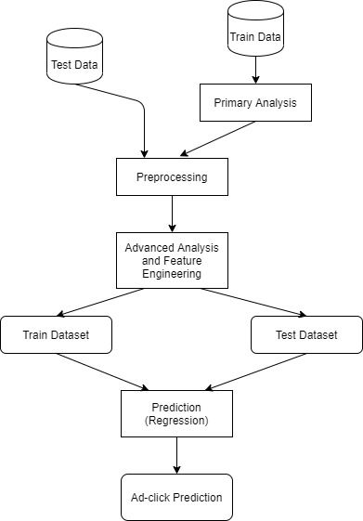
DATA PROCESSING

Slide 6
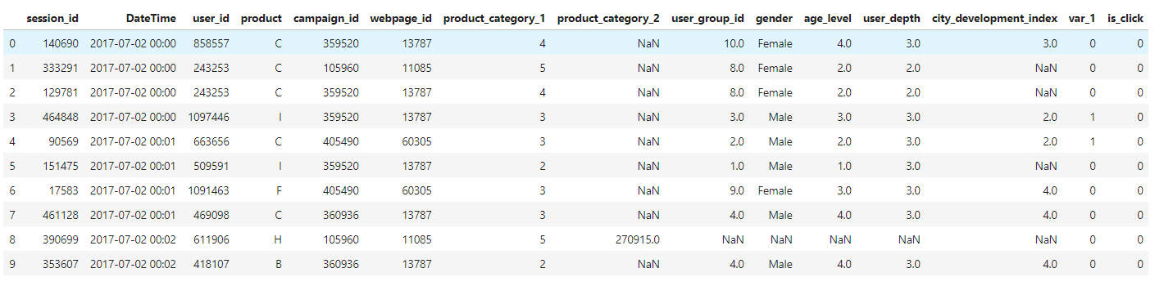
DATASET PREVIEW

Slide 7
APPROACH

Slide 8
EDA and DATA CLEANSING
EDA refers to the critical process of performing initial investigations on data to discover patterns, to spot anomalies and to test hypothesis
We plotted different bar graphs, count plots, heat map and histograms to understand the pattern of the data and draw insights from it
Data cleansing is a process of preparing the data for analysis by removing or modifying data that is incorrect as it not helpful for analyzing data
We used heatmaps for finding columns having null values. By understanding the interdependency among various fields, we replaced the null values with most approximate digits.

Slide 9
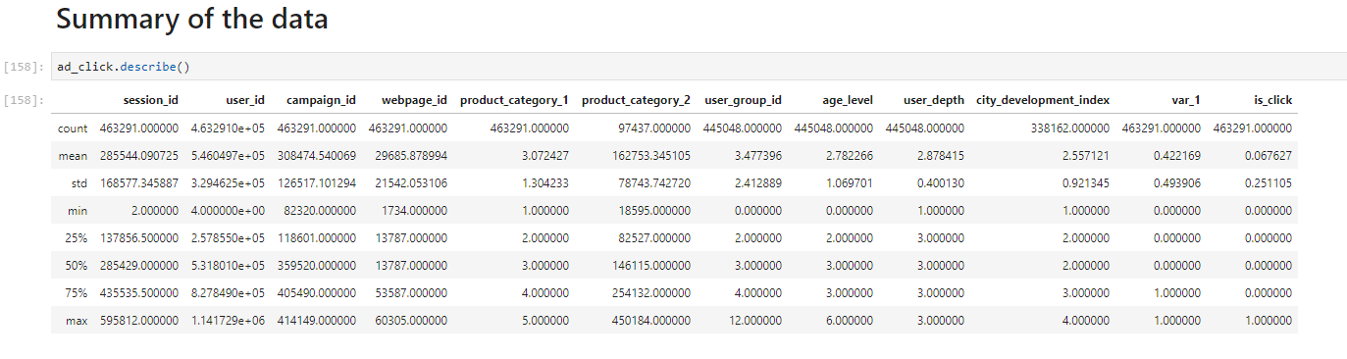
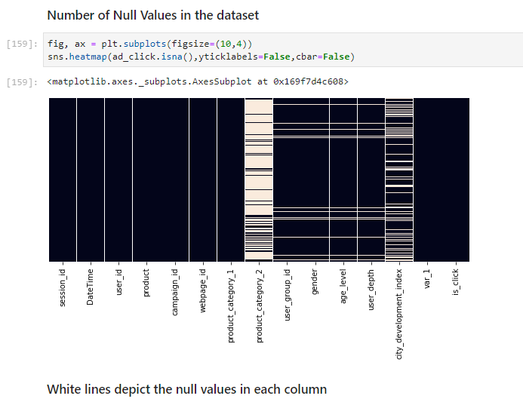
EDA and DATA CLEANSING

Slide 10
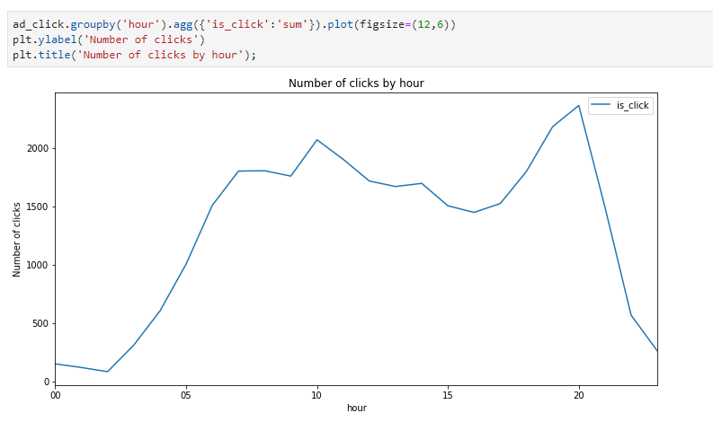
EDA AND DATA CLEANSING

Slide 11
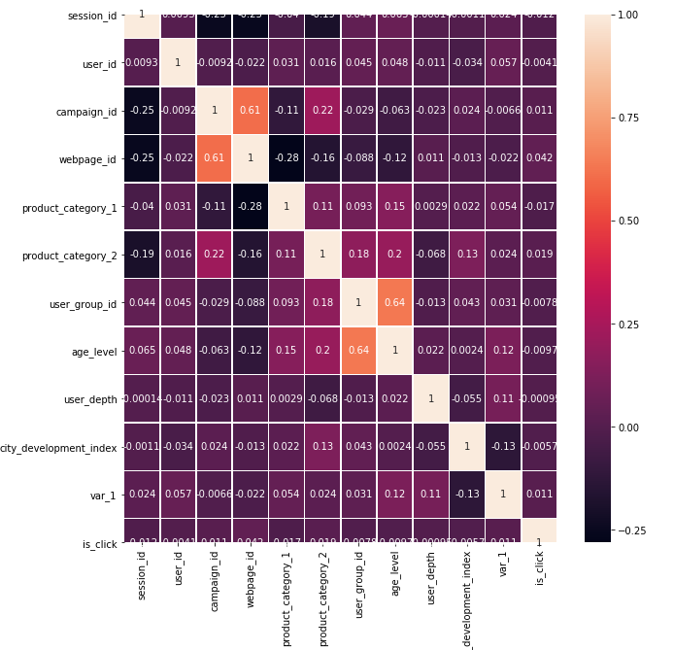
EDA AND DATA CLEANSING

Slide 12
ALGORITHMS

Slide 13
LOGISTIC REGRESSION
Since the aim is to analyze the features and determine whether the Ad is clicked or not, i.e either a ‘1’ or ‘0’, logistic regression was picked.
Pros of Logistic Regression:
Low Variance
It provides Probability scores for Observations
Easy to implement, interpret and very easy to train

Slide 14
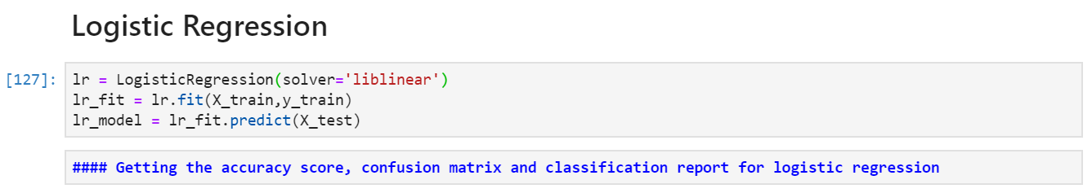
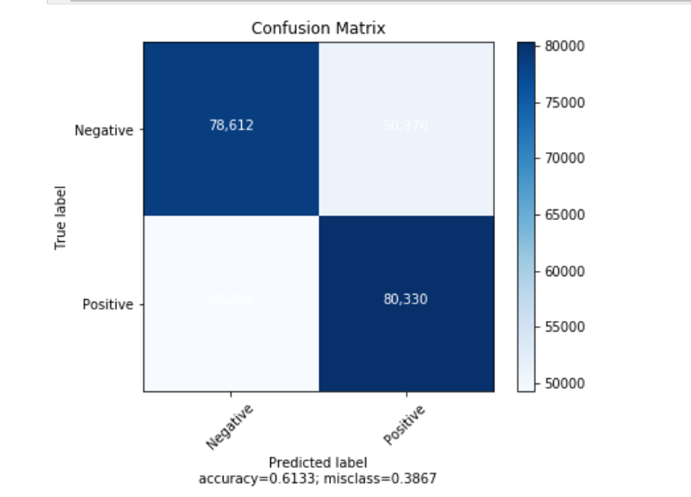
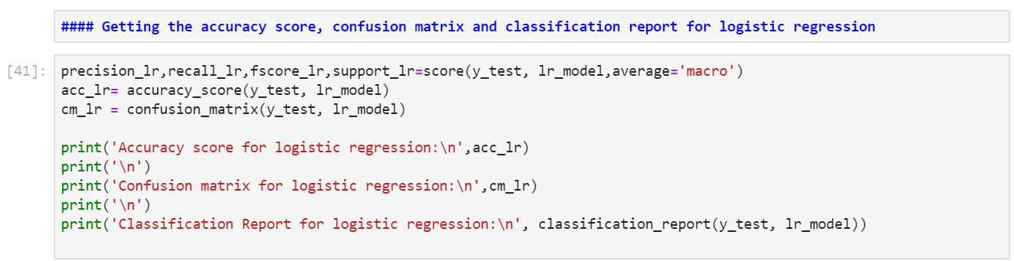
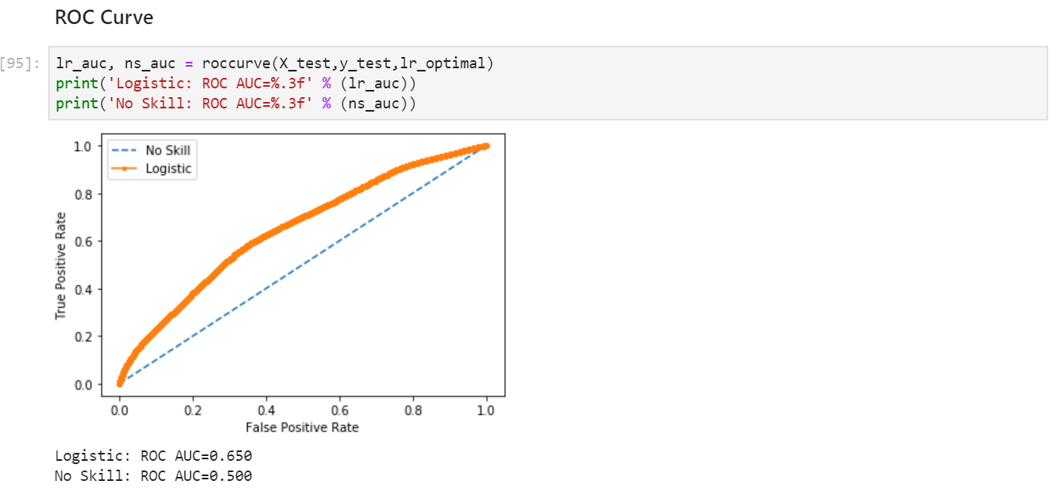
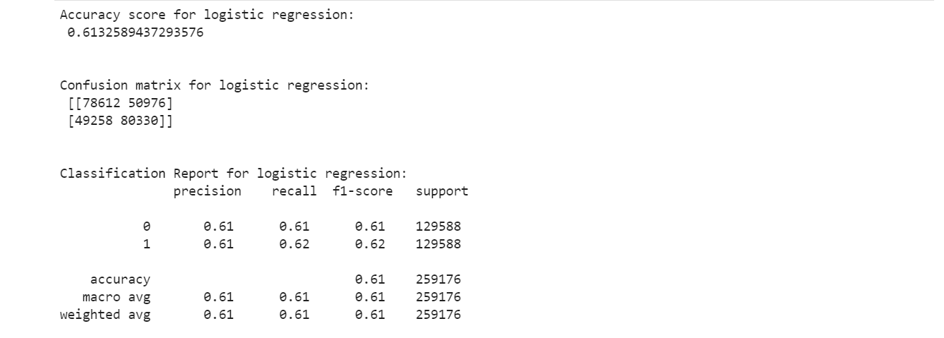

Slide 15
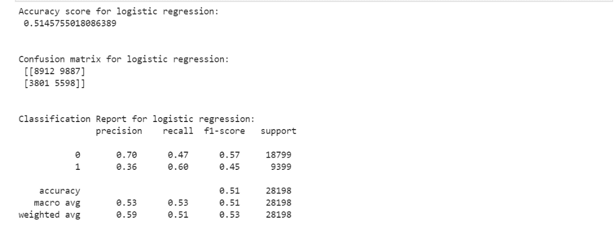
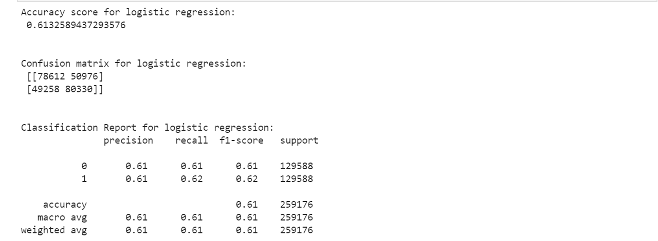
Undersampling results
Oversampling results
ROC Curve for Logistic regression:
ROC Curves summarize the trade-off between the true positive rate and false positive rate for a predictive model using different probability thresholds.

Slide 16
DECISION TREE
Decision Trees are a type of Supervised Machine Learning where the data is continuously split according to a certain parameter.
Pros using Decision Tree:
It is very interpretable and doesn’t require normalization of data
It deals well with noisy or incomplete data.
It can be used for both regression and classification problems.
Since decision trees have in-memory classification models, they do not bring in high computation costs, as they don’t need frequent database lookups.

Slide 17
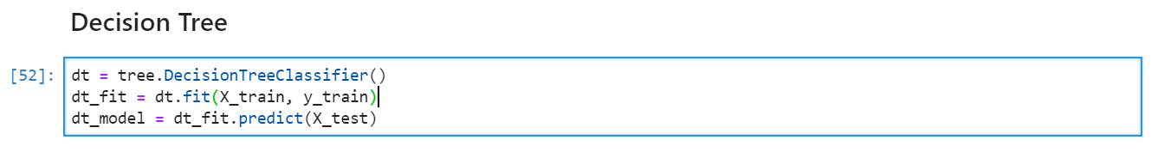
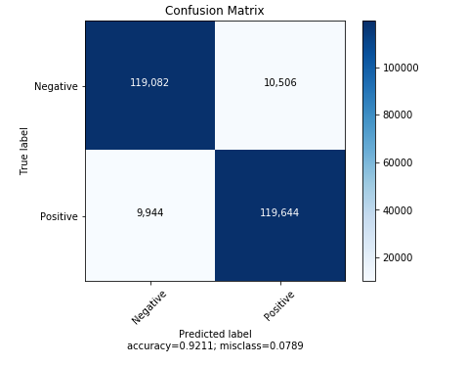
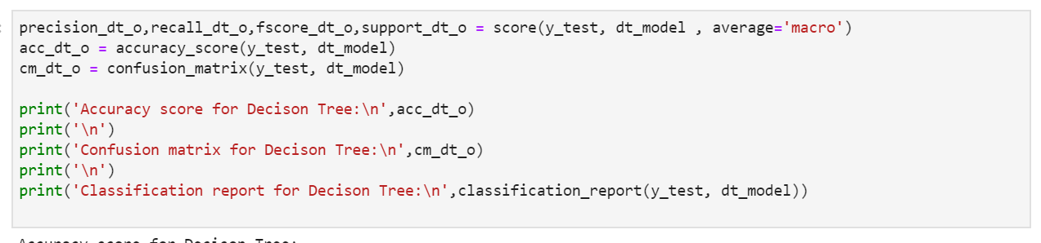
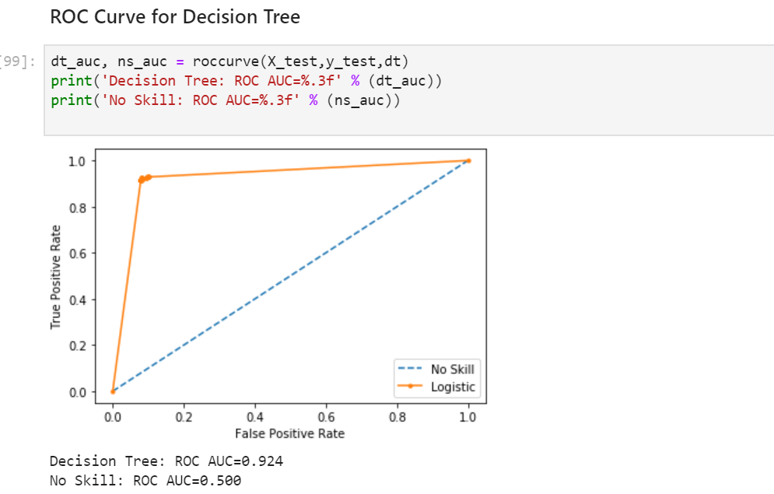
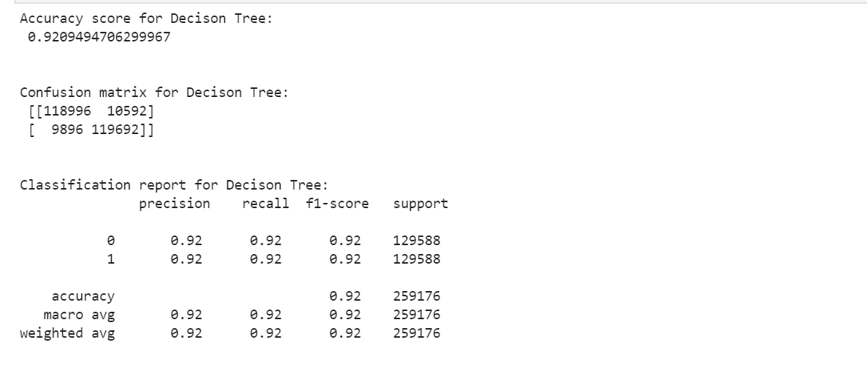

Slide 18
GRADIENT BOOSTING
Gradient Boosting we train a decision tree in which each observation is assigned an equal weight
The weights are altered after the first tree based on the difficulty of the classification
The algorithm boosts its performance by using gradients in the loss function
The algorithm is built sequentially, hence model takes long time to compile

Slide 19
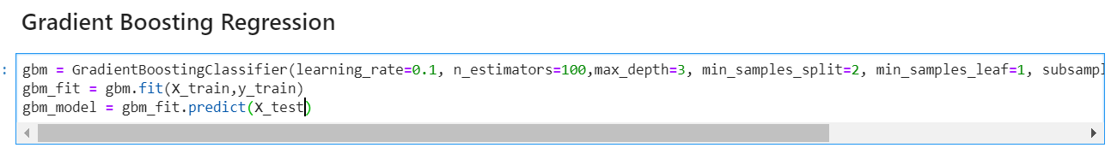
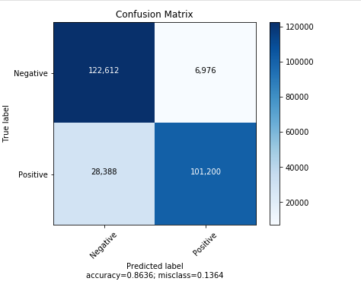
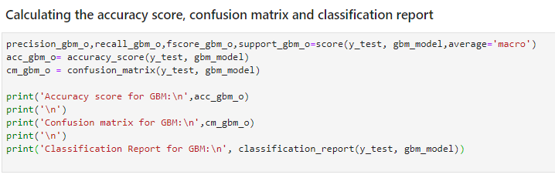
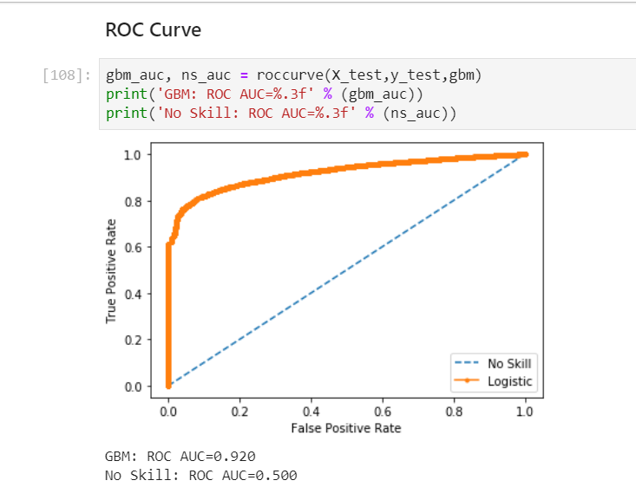
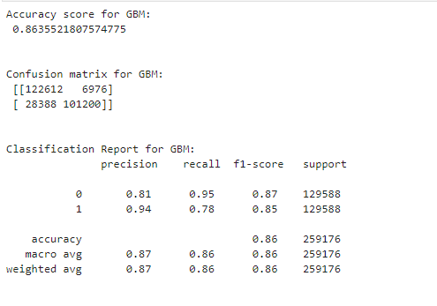

Slide 20
RANDOM FOREST
Random Forest Algorithm combines more than one algorithm of same or different kind for classifying objects.
Random forest classifier creates a set of decision trees from randomly selected subset of training set
It then aggregates the votes from different decision trees to decide the final class of the test object.
As the data is highly unbalanced random forest may be a better choice.
It offers feature selection for identifying most relevant features.

Slide 21
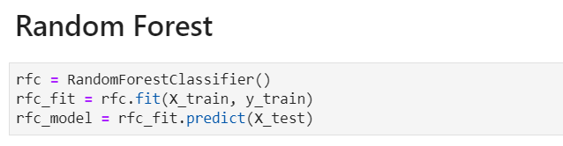
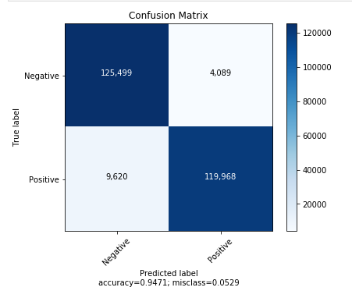
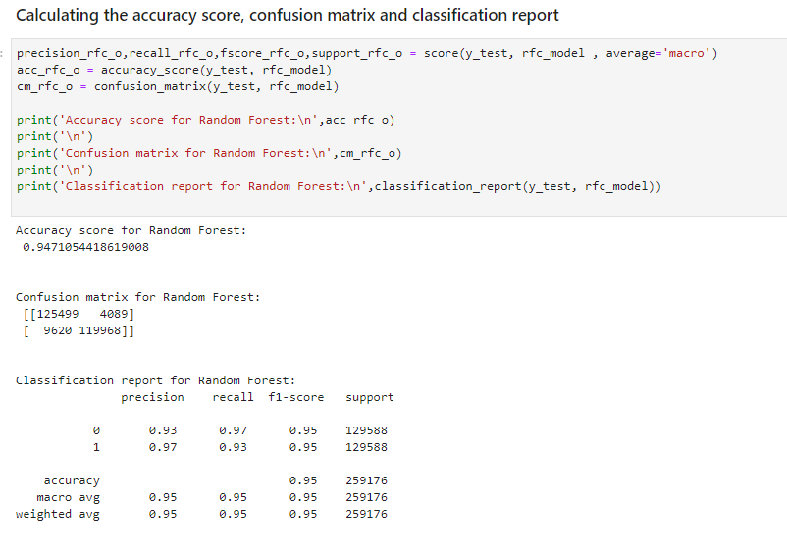
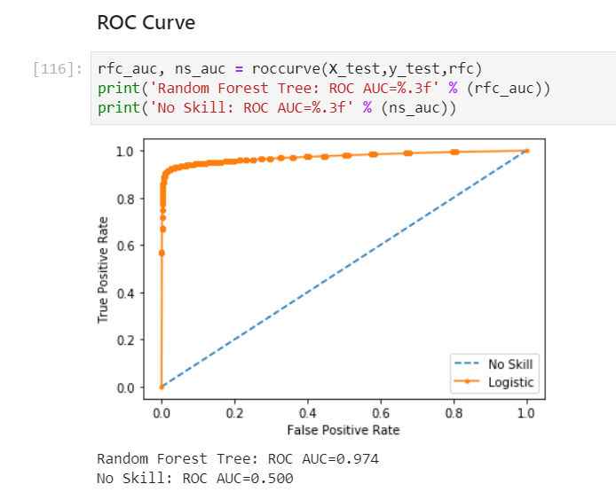

Slide 22
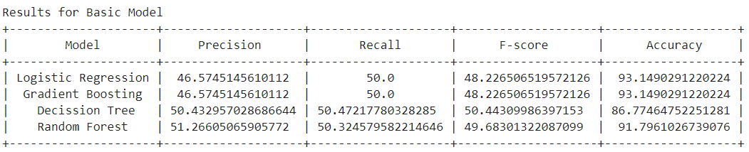
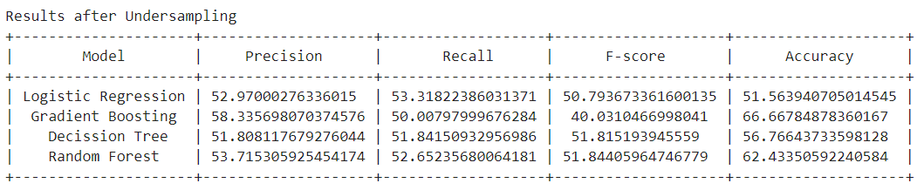
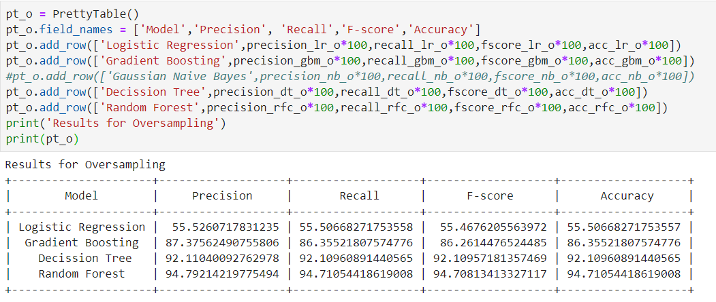
RESULT AND ANALYSIS
After comparing all the algorithms, Random Forest after oversampling gives us the best result

Slide 23
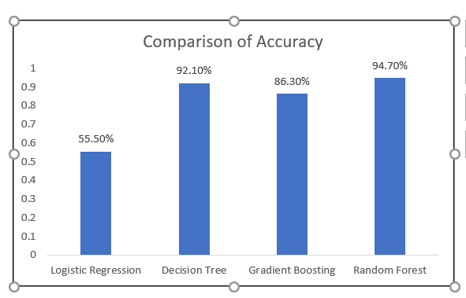
Comparison of accuracy

Slide 24
conclusion
Our project successfully achieved an advertisement click prediction model which has a relative high prediction and accuracy
By using Random Forest Classifier, we have achieved highest accuracy of around 95%.
By using Decision Tree, we have achieved an accuracy of around 92%.
Oversampling the imbalanced dataset gave us more desirable result.
But the time taken for predicting the output for decision tree was less compared to random forest.

Slide 25
Future scope
This model can be used as a recommendation system which demonstrates the potential targeting user group.
The model can be further enhanced by considering more features that can be used for prediction. As the data keeps on growing with this system, we can design a custom model that do not compromise on accuracy while delivering fast predictions

Slide 26
References
M. Sree Vani, Prediction of Mobile Ad Click Using Supervised Classification Algorithms, in International Journal of Computer Science and Information Technologies, Vol. 7 (2), 2016, 623-625
S. Saraswathi, Vallidevi Krishnamurthy, D. Venkata Vara Prasad, Tarun R K, S Abhinav and D. Rushitaa, Machine Learning Based Ad-click Prediction System, in International Journal of Engineering and Advanced Technology (IJEAT), pp.3646-3648, 2019
Sen Zhang, Qiang Fu and Wendong Xiao, Advertisement Click-Through Rate Prediction Based on theWeighted-ELM and Adaboost Algorithm

